Slide 1



Warsaw University Of Technology
Faculty of Mathematics and Information Science

Slide 2
Outline
Introduction
Problem Statement
System Architecture
Result Evaluation
Application Design
Conclusion
Reference

Slide 3
Introduction
During the pandemic, a significant amount of widely circulated news contains false information. Particularly on social media platforms, where people from all over the world have constant and simple access to upload materials and posts.
Fake news has had violent consequences in the past and continues to do so now. Today, particularly in the midst of a pandemic, social media platforms are being utilized to spread misinformation at breakneck speed. To combat the fatigue of fake news, we should either shun news altogether or use tools such as machine learning.

Slide 4
Problem Statement
COVID fake news is life-threatening.
Problem Faced:
Increasing dataset is done by adding articles that are already in broadcast, and correctly identifying them as true or fake. It is hard to distinguish them, as large numbers could be fake.
Our goal is to distinguish and detect fake news from a given dataset of news articles.

Slide 5
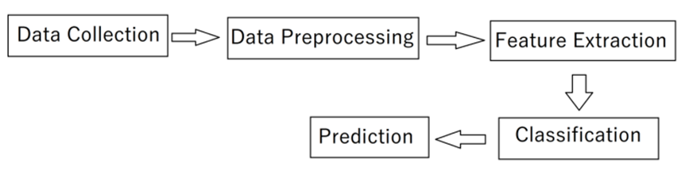
System Architecture
Figure 1: System Architecture

Slide 6
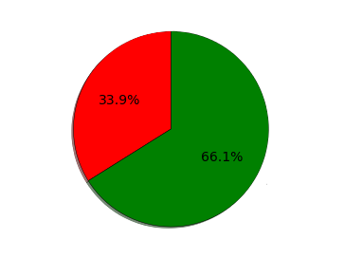
Data Collection
The data for COVID-19 fake news has been acquired from the Mendeley Data website [1].
It has 5 columns, namely: number, title, text, category, and label.
Title: Title of the news article.
Text: The news article.
Category: True, False, or Partially false.
Label: 1 if the news is true. 0 if the news is false or partially false.
Fake News
True News

Slide 7
Data Preprocessing
Text Cleaning
Lowercase
Remove Punctuation
Remove URLs
Remove @tags
Remove Special Characters
Preprocessing Operations
Tokenization
Removing Stop Words
Lemmatization

Slide 8
Feature Extraction
TF-IDF Model
Creating the histogram
frequent words from dictionaries
TF Matrix
IDF Matrix
TF-IDF Calculation

Slide 9
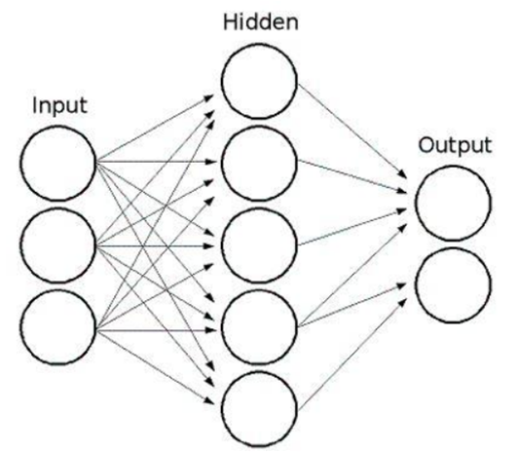
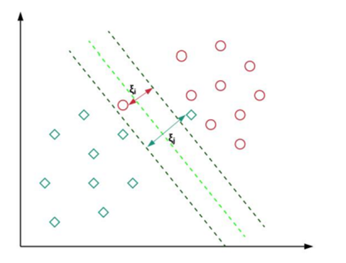
Classification Models
MLPs SVM
Figure 2: MLPs with one hidden layer [2]
Figure 2: SVM with Kernel Trick[3]

Slide 10
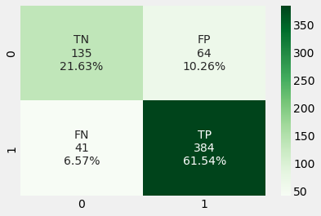
Result Evaluation
Confusion Matrix Visualization

Slide 11
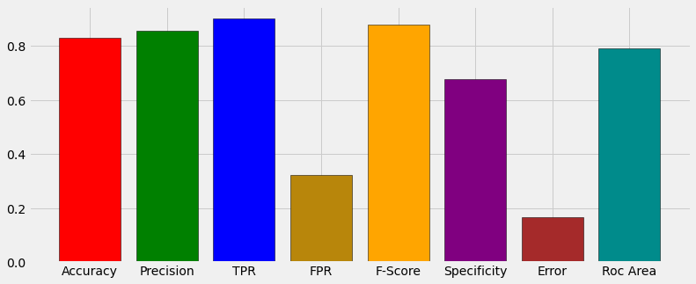
Result Evaluation (Cont'd)
Result Visualization

Slide 12
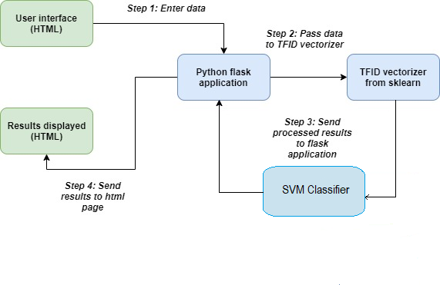
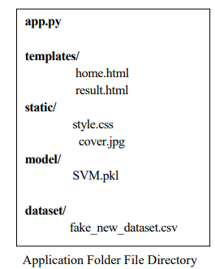
Application Design
Figure 3: Application Design

Slide 13
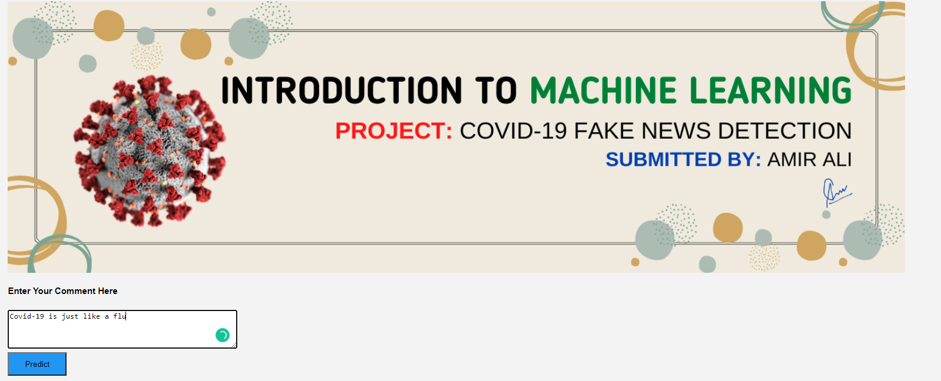

Application Design (Cont’d)
Example

Slide 14
Conclusion
The goal of this project was to find capable methods and settings that could be used to help the detection of Cocid-19 Fake News. The error rate of the model is not zero, so still, some fake news can be classified as true by the model. In the future, we will enhance this work by implementing Temporal Convolutional Network (TCN) and Random Multimodel Deep Learning (RMDL) Techniques.

Slide 15
Reference
[1] https://data.mendeley.com/datasets/zwfdmp5syg/1
[2] Amir Ali, Zain Amin, “An Intuitive Guide of Artificial Neural Network with Practical Implementation in Keras and Tensorflow”, Wavy AI Research Foundation, Pakistan, 2019.
[3] Amir Ali, Zain Amin, “A Deep Level Understanding of Support Vector Machine with Practical Implementation in Scikit-Learn”, Wavy AI Research Foundation, Pakistan, 2019.

Slide 16
Thank You☺

